Slide 1
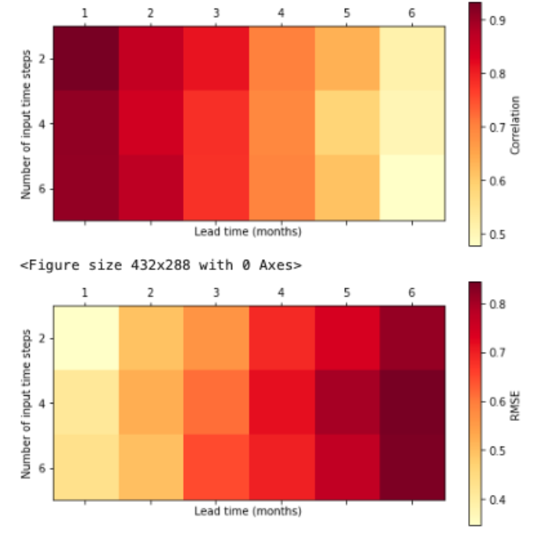
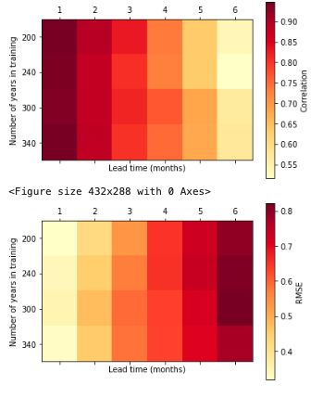

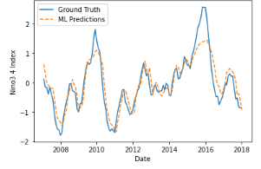
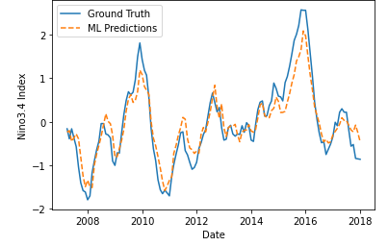
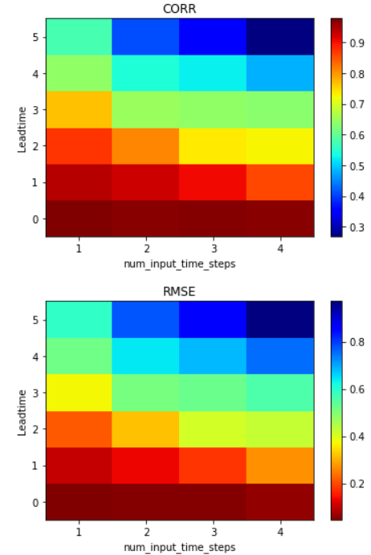
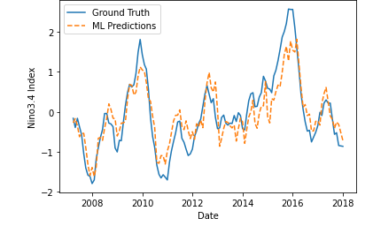
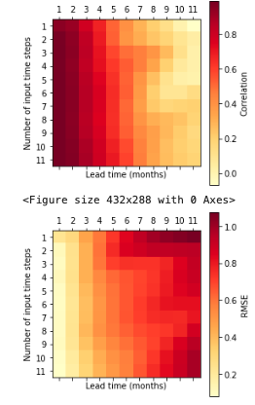
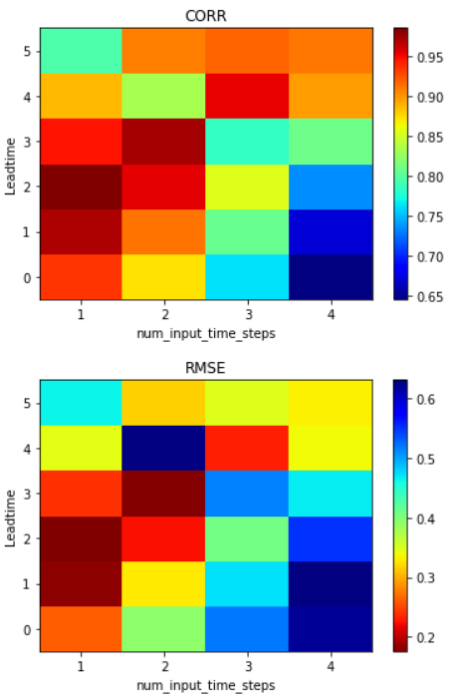
Team 66: <El Niño>
Team Member: Deborah Khider, Tse-Chun Chen, Connor Aghili, Cora Frederick
Two Layer CNN
Applications to Exercise 5- 7
Two Layer CNN Notebook Default
Auto-sklearn & Auto-Pytorch: Both automatically searches for the ‘right’ MLing algorithm for a new MLing dataset and optimizes hyperparameters!
Methods
Number of input time steps
Two Layer CNN: Corr: 0.92 RMSE 0.37
Auto-PyTorch: Corr 0.96 RMSE 0.12
Lead time (months)
Auto-Sklearn
Lead time (months)
num_epochs = 7, time_steps & lead time 1
Train GCMS 1860-2100
Time_steps = 3, Leat time =1
Train: 1960-2005
Auto-Sklearn: Corr 0.91 RMSE 0.18
Major Takeaways:
Auto-PyTorch compared to Two Layer CNN does extremely well!
And more inputs is beneficial only if you’re doing predictions for longer leadtime
Number of input time steps
Linear Regression with era5 dataset
on Nino3.4 Region
CORR
RMSE
Number of input time steps
Time_steps = 3, Leat time =1
Train: 1960-2005
Number of input time steps
Lead time (months)

Slide 2
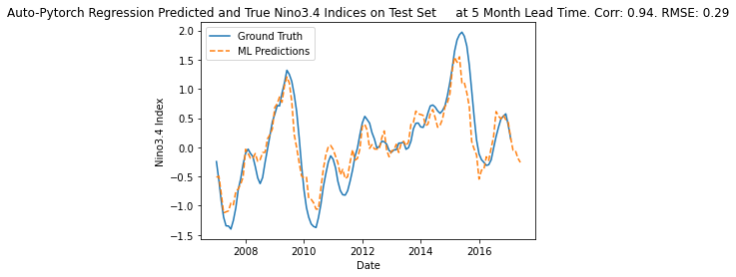
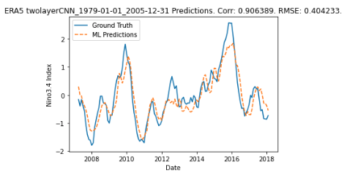
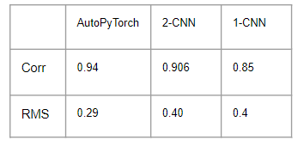
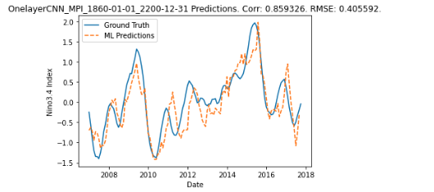
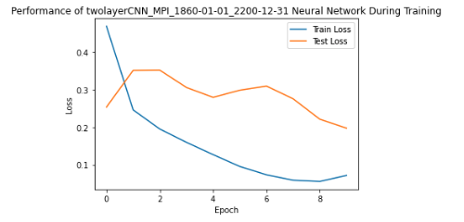
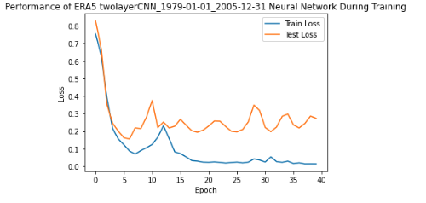
Team 66: <El Niño>
Team Member: Deborah Khider, Tse-Chun Chen, Connor Aghili, Cora Frederick
Applications to Exercise 8
An issue which comes up with MLing and NNs is Optimization
How many layers
Performed better with less layer
How long to train
Increasing the training period helped with making predictions at long lead times
Train Data Is Extremely Important
where it’s provided from such as observations or models affect accuracy
Other notable variables
Lead time
Time step
A Great way to visualize Performance of Data is with Train and Test Loss Curves
Methods: CNNs and Auto-Pytorch
different data used and parameterization per model

